Slide 1

Vignan’s Institute of Management and Technology for Women
Department of AI and ML
HealthCare ChatBot
D.Likhitha MahaLaxmi (20UP1A6611)
G.Shravani (20UP1A6614)
M.Shruthi (20UP1A6632)
M.Sreeja (21UP5A6602)

Slide 2
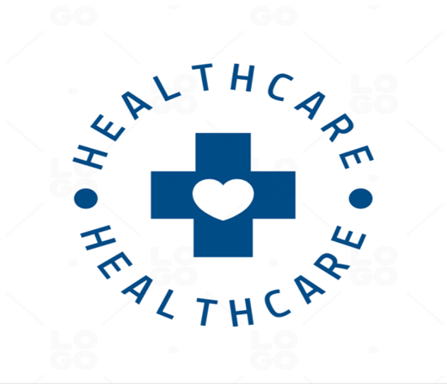
ABSTRACT
Health care is very important to start a good life. However, if you have a health problem, it is very difficult to talk to your doctor.
Chatbots can be used to communicate with text or voice interfaces and receive responses via artificial intelligence.
Chatbots are programs designed to automatically interact with incoming messages.
Chatbots can be programmed to respond the same each time and respond differently to messages containing specific keywords.
More and more hospitals, nursing homes, and even private centers are now using online human service chatbots on their websites. These bots connect with potential patients accessing the site, find specialists, make appointments, and ensure appropriate treatment.

Slide 3
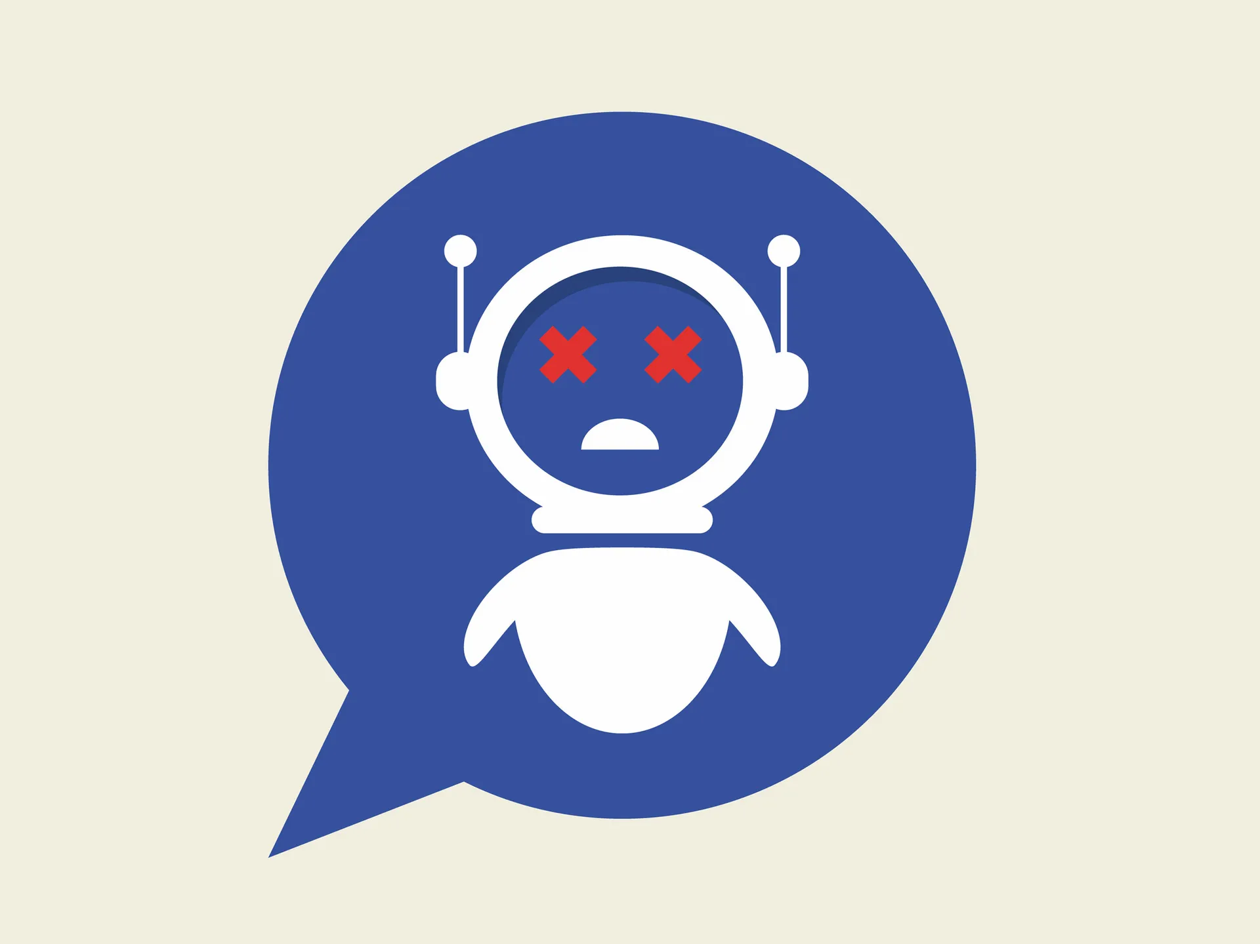
INTRODUCTION
What is a Healthcare Chatbot?
A healthcare chatbot is a software application that uses AI and NLP to simulate a conversation with users, addressing their health-related queries and providing assistance in various aspects of healthcare. These chatbots can be integrated into websites, mobile apps, or messaging platforms, making them easily accessible to users.
Healthcare chatbots serve multiple purposes, including:
Answering general health questions.
Providing information about specific medical conditions, symptoms, and treatments.
Assisting users in finding nearby healthcare facilities, doctors, or pharmacies.
Offering medication reminders and helping users manage their prescriptions.
Collecting and recording health data such as symptoms, vital signs, or medical history.
Guiding users through first aid or emergency procedures.

Slide 4
LIMITATIONS AND GAPS
Lack of personalization: Many existing healthcare bots provide generic information and responses, which may not be tailored to the specific needs and conditions of individual patients. This can lead to inaccurate or incomplete advice.
Limited understanding of context: Healthcare bots often struggle to understand and interpret complex medical queries or symptoms due to their limited understanding of context. This can result in incorrect diagnoses or recommendations.
Inability to handle emergencies: Existing healthcare bots are typically not equipped to handle emergency situations or provide immediate assistance in critical conditions. They may lack the ability to recognize urgent symptoms and direct patients to seek immediate medical attention.
Ethical concerns: Healthcare bots might face ethical challenges when it comes to handling sensitive patient information, maintaining privacy, and ensuring data security. Patients may have concerns about sharing personal health data with a bot.
Lack of human touch: Some patients prefer human interaction and empathy when discussing their health concerns. Existing healthcare bots often lack the ability to provide emotional support or empathetic responses, which can be important in certain healthcare scenarios.

Slide 5
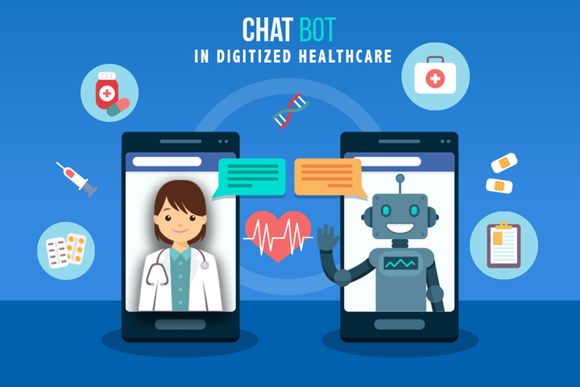
EXISTING HEALTHCARE SYSTEM
TRADITIONAL HEALTHCARE
01
•Patients need to book an appointment to see a doctor
•Long waiting times before seeing healthcare providers
•Hospital staff sometimes overlook patient needs
AI CHATBOT HEALTHCARE
•Chatbots are available 24/7, improving availability and convenience.
•Use machine learning to learn from past experiences, identifying patterns and offering the best solution.
•Personalised care leads to patients feeling heard and their needs being addressed.
02
AFFORDABLE HEALTHCARE
03
•Chatbots are a much cheaper alternative to human medical professionals.
•As chatbots don't have to be physically present, medical consultations can be handled remotely, further reducing costs.

Slide 6
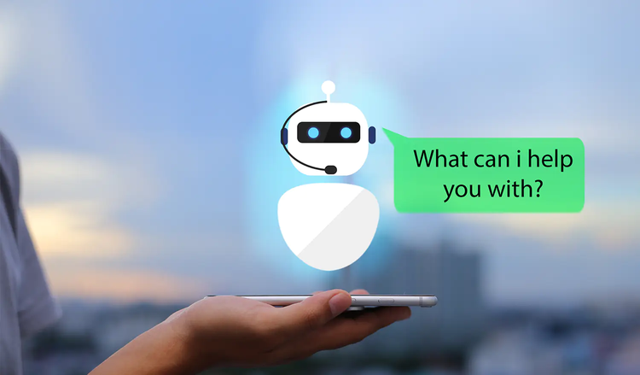

PROPOSED SYSTEM
24/7 Availability
Personalised Patient Care
Patients can get medical advice and assistance any time of the day through AI chatbots.
Patients can receive individualised recommendations based on their medical history and preferences.

Slide 7
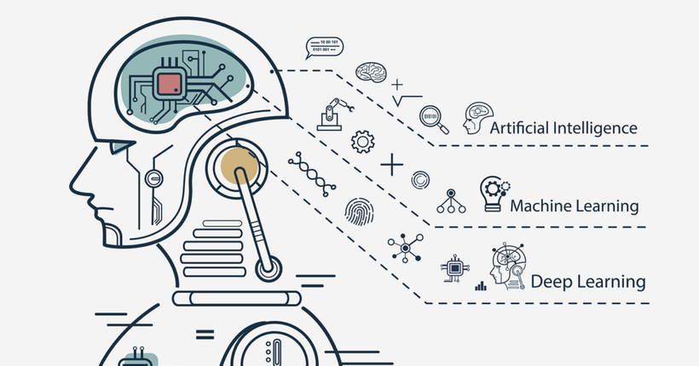

PROPOSED SYSTEM
Machine Learning-Powered Automation
Virtual Healthcare Providers
Chatbots with machine learning technology learn from their previous interactions, improving functionality and the patient experience over time.
Chatbots can replace the work of healthcare providers with cheaper, more convenient, and 24/7 availability.

Slide 8



24/7 AVAILABILITY
The chatbot is always ready to provide assistance, regardless of the time of day.
ADVANTAGES OF PROPOSED SYSTEM
NO WAITING
With the chatbot, users can avoid long waiting times at the hospital or clinic.
INCREASED EFFICIENCY
In just a few clicks, the chatbot can gather information, diagnose health issues, and provide prescriptions.

Slide 9
PROPOSED METHODOLOGY
The proposed Chatbot system functions based on a Decision Tree algorithm.
For Example
If user is having that particular symptom for more than 13 days then, chatbot will respond as "You should take the consultation from doctor".If it is less than 13 days then chat bot will respond as, "It might not be that bad but you should take precautions". After predicting the disease, the bot will give necessary precautions that one must take. After predicting the disease,the bot will give a basic description about the disease, as the user will get an idea of what disease that user might be facing.
Bot will respond to everything in voice,for that we have used pyttsx3. pyttsx3 is a text-to- speech conversion library in Python. Unlike alternative libraries, it works offline and is compatible with both Python 2 and 3. It generates responses for the user queries based on the following method

Slide 10
IMPLEMENTATIONS
Hardware Requirements
Processor : AMD Ryzon 3, Intel Chip i3 or Above.
RAM : 4GB.
Hard Disk : 256GB.
Input Devices : Mouse, keyboard.
Software Requirements
Operating System : Windows 10.
Language : Python.
Libraries : Numpy, pandas.

Slide 11
PERFORMANCE EVALUATION
Accuracy of Responses : Measure how accurately the chatbot responds to user queries. This can be done by comparing the chatbot's answers to a trusted source or by collecting feedback from healthcare professionals.
Relevance of Information :Evaluate the chatbot's ability to provide relevant and up-to-date healthcare information. Ensure that it offers information that is appropriate for the user's context and needs.
User Satisfaction:Gather user feedback through surveys, ratings, and direct input to assess user satisfaction. Pay attention to user comments and suggestions for improvement.
Response Time:Analyze the chatbot's response time to ensure that it provides prompt answers. Users typically expect quick responses, especially in healthcare scenarios.
Conversational Quality:Assess the chatbot's ability to engage in natural and coherent conversations with users. Evaluate the chatbot's use of language, tone, and empathy in interactions.

Slide 12

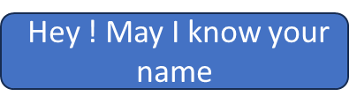


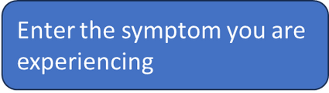

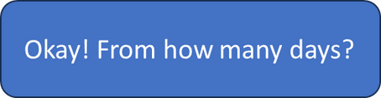




WORKING OF HEALTHCARE CHATBOT

Slide 13




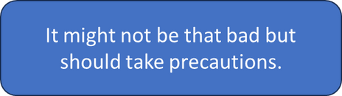
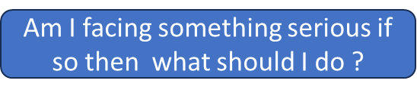
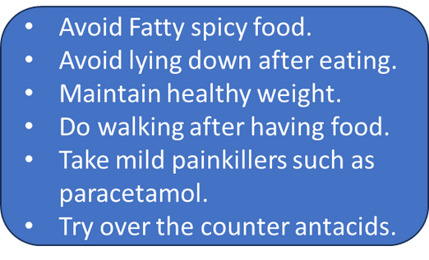
WORKING OF HEALTHCARE CHATBOT

Slide 14
ALGORITHM
Decision Tree Classifier.
WNatural Language Processing
NLP LIBRARIES.
Insert user query in the chatbot window.
The details will be extracted from the user chat.
Decision Tree classifier algorithm is used to process the query.
The response is fetched from the chatbot like Disease Prediction and Disease Precaution and output to the user.
Exit
Scikit-learn : It provides a wide range of algorithms for building machine learning models in Python. Natural language Toolkit (NLTK): NLTK is a complete toolkit for all NLP techniques.
Pattern : It is a web mining module for NLP and machine learning.
TextBlob : It provides an easy interface to learn basic NLP tasks like sentiment analysis, noun phrase extraction, or pos-tagging.
Quepy : Quepy is used to transform natural language questions into queries in a database query language.
SpaCy : SpaCy is an open-source NLP library which is used for Data Extraction, Data Analysis, Sentiment Analysis, and Text Summarization.
Gensim : Gensim works with large datasets and processes data streams.

Slide 15
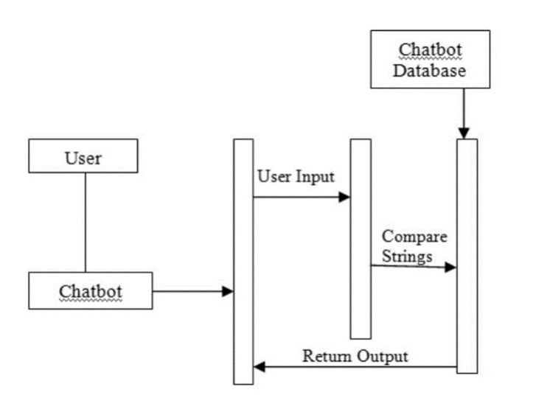
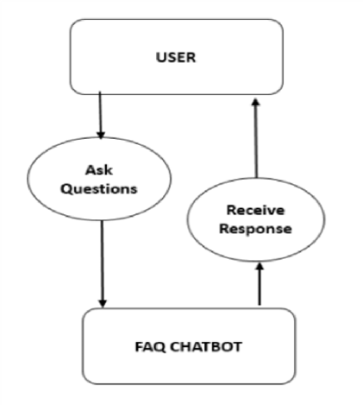
UML DIAGRAMS
Class Diagram
Sequence
Diagram

Slide 16
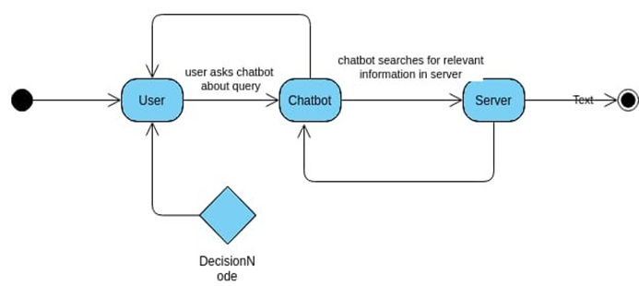
UML DIAGRAMS
Activity
Diagram

Slide 17
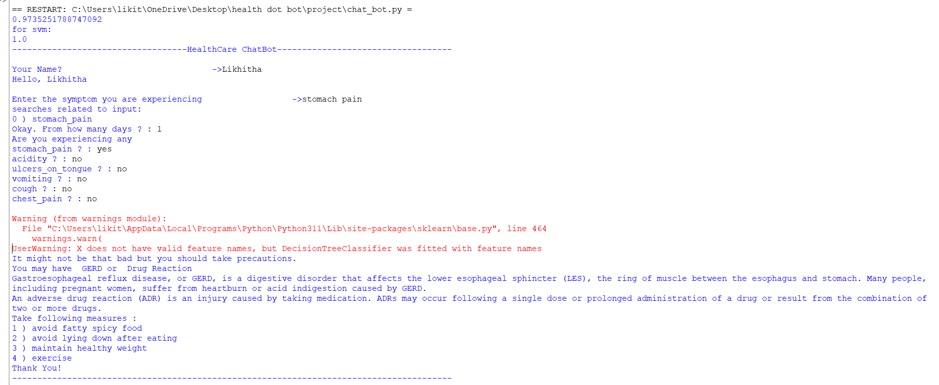
EXAMPLE

Slide 18
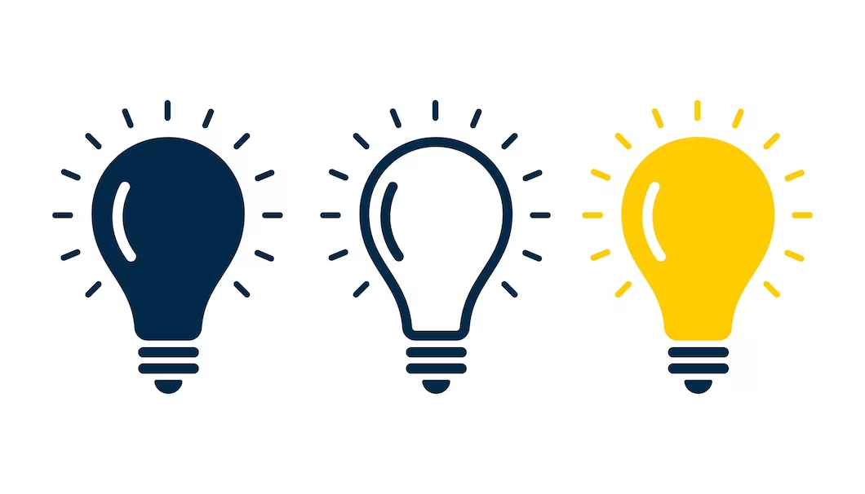
Conclusion
Integrating artificial intelligence powered chatbots in healthcare delivery models can transform the industry as we know it. Remote patient care improves accessibility and guarantees that everyone has access to high-quality healthcare. Machine learning and natural language understanding algorithms make these chatbots smarter, working 24/7 to provide personalised healthcare solutions to each patient. The future of healthcare is here, and chatbots are playing a crucial role in driving this transformation.

Slide 19


